Slide 1
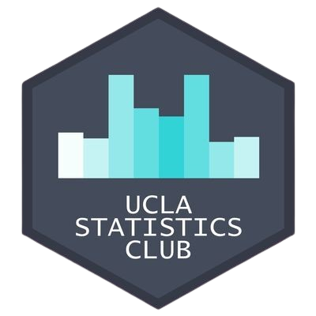
Intro to EDA Workshop
Benjamin Yu & Reeshad Mohammed & Jessica Ye

Slide 2


About the Presenters
Reeshad
Mohammed
Benjamin Yu
Workshop Co-Chair
Data Theory Major
Workshop Co-Chair
Statistics & Applied Math Majors, Digital Humanities Minor

Slide 3
Table of Contents
01
Pandas Basics
Some basic commands from the Pandas package
02
Cleaning Data
Cleaning data
03
Exploring Relationships
Explore relationships within and between variables
04
Next Steps
What to do after preliminary analysis
05
Datathon: Questions & Updates
Ask your questions regarding the datathon

Slide 4
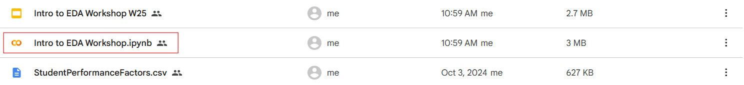
Instructions
Open Google Drive Link: https://tinyurl.com/IntroToEDAW25
Click on “Intro to EDA Workshop.ipynb”
Additional note: all our workshops are on GitHub: https://tinyurl.com/UCLAStatsWorkshops

Slide 5

Introduction
Pandas is the package primarily used for working with CSV files.
Two main structures:
Series: A one-dimensional labeled array (like a single column of a spreadsheet)
DataFrame: A two-dimensional table (like a full spreadsheet).

Slide 6
Subsetting
Single bracket: one column
Ex: df[‘col1’]
Double bracket: multiple columns
Ex: df[[‘col1’, ‘col2’]]
Row subsetting:
loc: may pass in indexes or column names
df.loc[“a”]
iloc: may only pass in indexes
Ex: df.iloc[1]

Slide 7
Arithmetic Operations on Dataframes
.add(), .radd() and .sub(), .rsub()
.mul(), .rmul() and .div(), .rdiv()
.floordiv(), .rfloordiv() (floor division)
.pow(), .rpow() (exponentiation)

Slide 8
Summary Statistics on Dataframes
count() - number of non NA values
quantile()
sum()
mean()
median()
mad() - mean absolute deviation
prod()
var(), std()

Slide 9
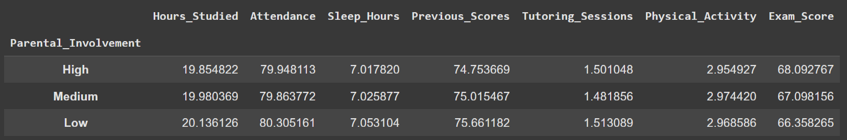
Grouping
We can group our data by certain characteristics and use summary statistics to get group-specific information about our data.

Slide 10

Working with Data
We will be applying some of the commands that we have learned to do some preliminary analysis on the student data dataset.

Slide 11
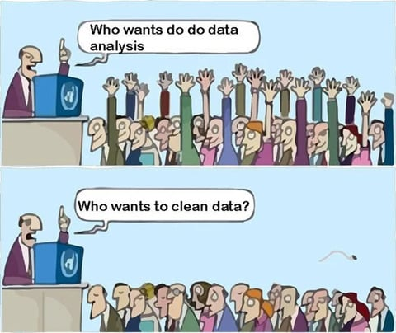
Cleaning Data
Missing and erroneous data are extremely common in datasets, and may appear for various reasons such as errors in collection of data or it could be intentional. Understanding how to approach & the impact of missing data is important for a complete analysis. It is important to clean data of impurities prior to analysis.

Slide 12

Understand the Problem
Once you clean your data, the first step is being able to determine what problem/question you are trying to solve with this data. For this dataset, a sample problem could be "What are the contributing factors to students' performance on exams, and how can we do to improve students' scores?"

Slide 13
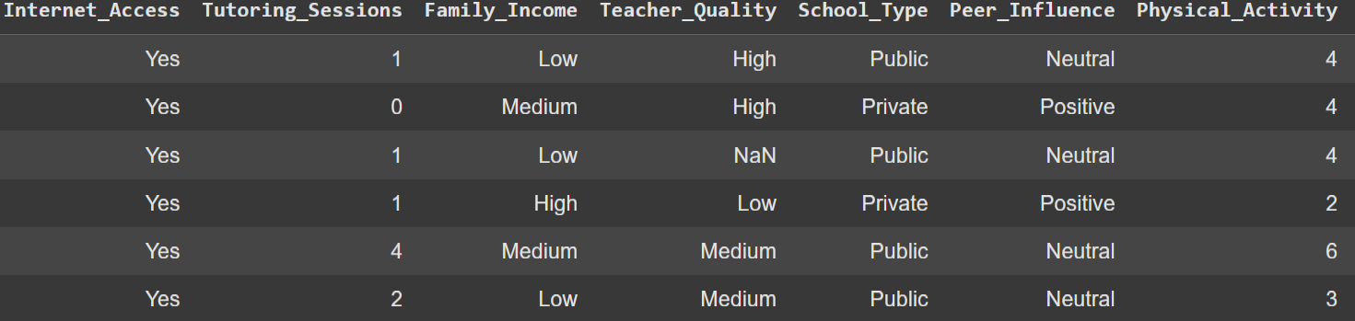
Missing Data

Slide 14
Approaches to Missing Data
Remove rows
Pros: simple
Cons: potentially loses important data from dataset
Numerical: replace NA values with mean/median values of data
Pros: keeps data
Cons: may bias the data towards mean/median

Slide 15
Outliers
Outliers are data which are far from the rest of the data. The general accepted way to find outliers are if the are 3x away from the 1st or 3rd quartiles, and is a suspected outlier if it is 1.5x away from the 1st or 3rd quartiles.
We do not want to remove outliers simply because they are outliers, as they may provide key information about the variable.

Slide 16

Exploring Relationships
It is important to understand the relationships between the variables in this dataset to gain a more rich understanding of the data. There are many ways to

Slide 17
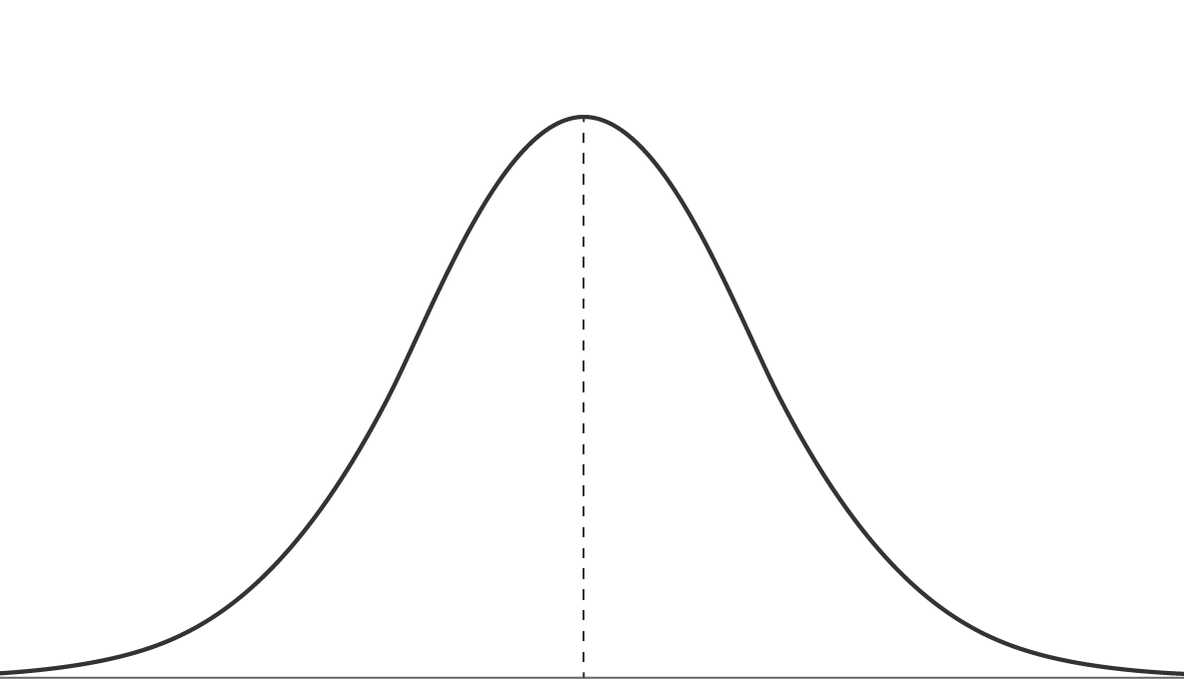
Univariate Analysis
Univariate analysis is exploring information from a singular variable, including summary statistics like mean & five-point summary and distributions of data

Slide 18
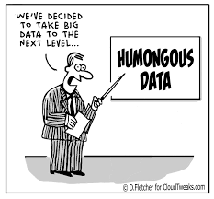
Multivariate Analysis
Univariate analysis is exploring information from a singular variable, including summary statistics like mean & five-point summary and distributions

Slide 19
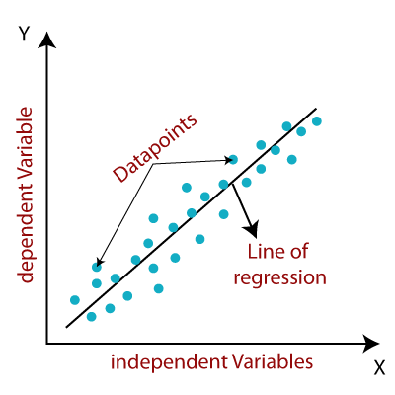
Linear Regression
Linear regression is a common tool used to predict certain variables (the dependant variable), by making the assumption that the dependant variable is linearly related to the independent variables.

Slide 20
Communicating Results
Once you have a basic analysis of the results, you should compile your most noteworthy results and communicate them clearly. A sample presentation should include:
Goals & scope of analysis
Summary & context of data
Key insights, patterns or anomalies, preferably with visuals
Limitations of analysis
Next steps

Slide 21
Future Directions
Other pandas functions
Matplotlib, seaborn
Clustering (K-means clustering, spectral clustering, etc)
Linear regression (how to evaluate the model & performance)

Slide 22
Credits
Miles Chen Stats 21 Course

Slide 23
Questions?

